Slide 1
Analyzing File Processing Time Using A 2X2X3 Design
Coleton Grossman
Pedro Castro

Slide 2
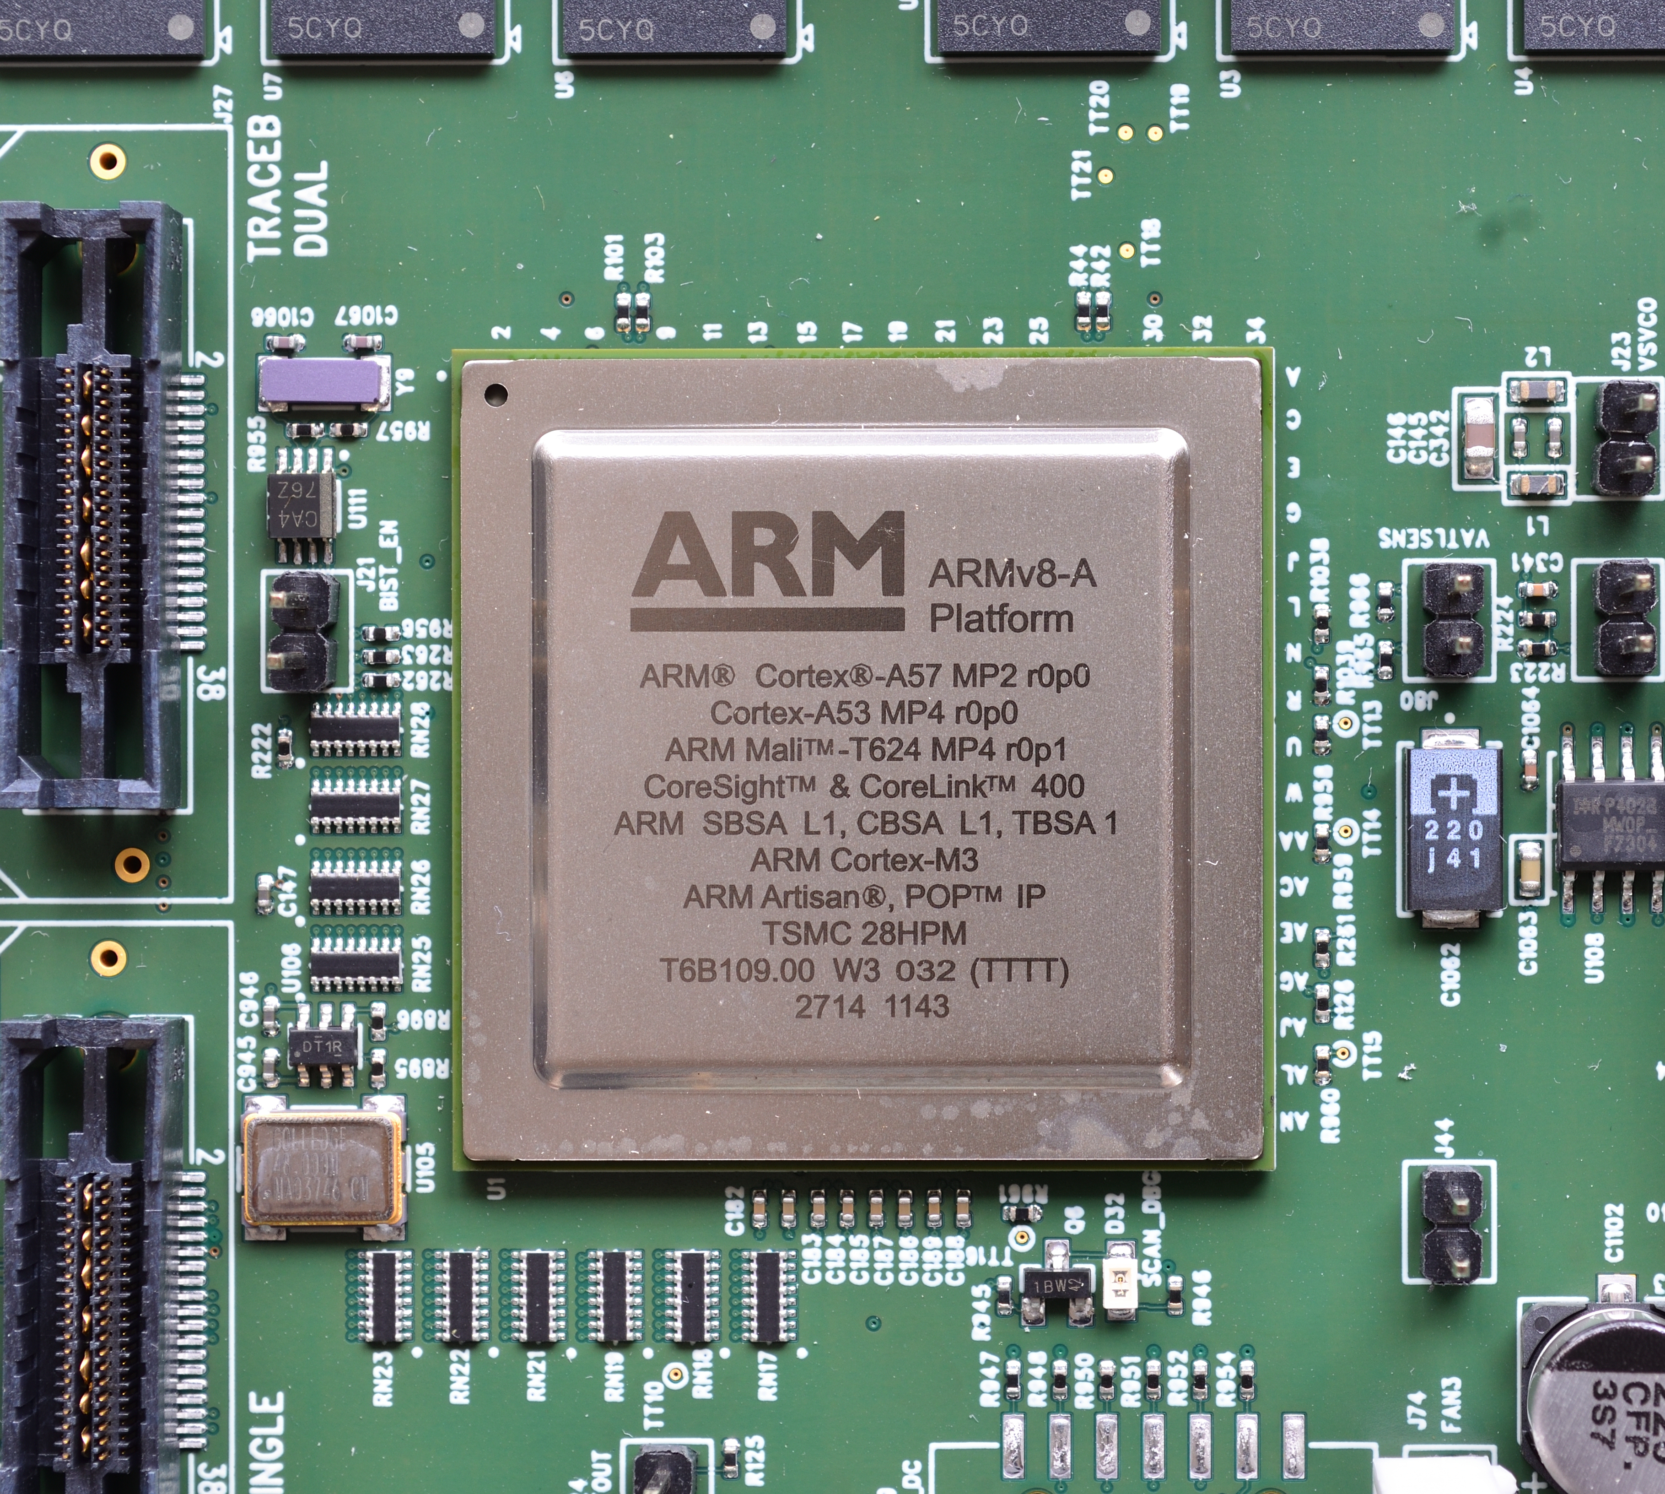
Purpose of Presentation
- test the time performance and resource utilization differences across different architecture systems when processing different sized files utilizing various levels of GPU parallelism, to determine if there is an actual difference in processing time between them

Slide 3
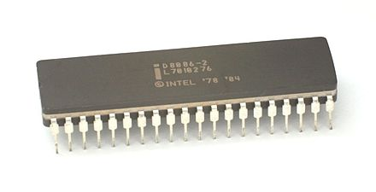
Design
2x2x3 mixed-level complete factorial design
architecture system (2 levels: x86+64 and aarch64)
File Size (2 levels: 0.5 GB, 2.75GB)
GPU Thread Count (3 levels, (1 GPU, 2 GPU, 3 GPU))
Three replication for each treatment combination

Slide 4
Data Gathering Methodology
A Python scripts designed to check computational performance by:
Creating Radomized Files utilized in both VMS in Google Cloud
Processing large files across multiple GPUs
Collecting real-time system metrics (CPU, memory, GPU utilization)
Testing different file sizes and GPU configurations
Generating comprehensive performance data

Slide 5
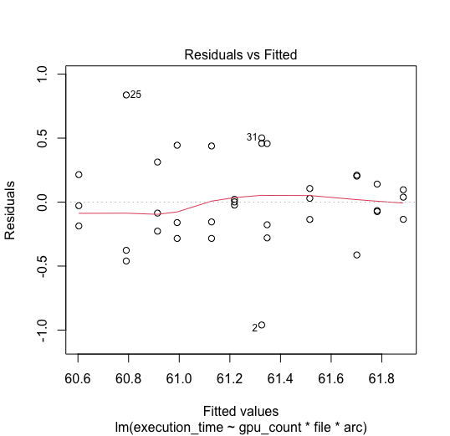
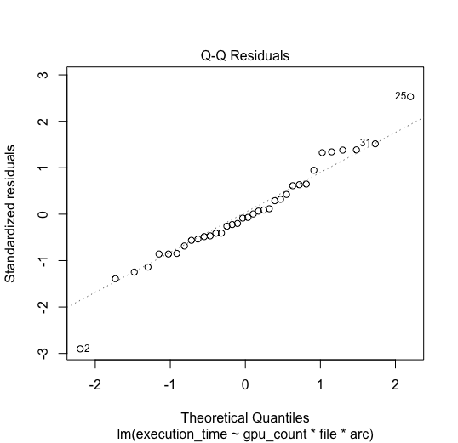
Checking Assumptions

Slide 6
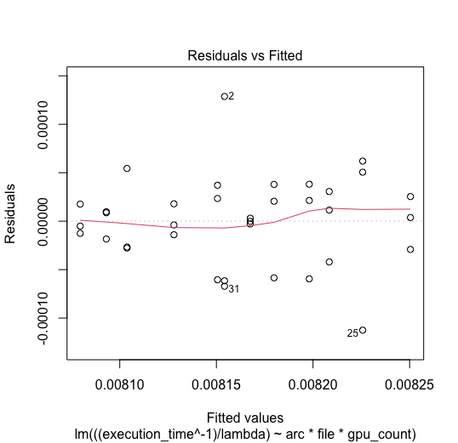
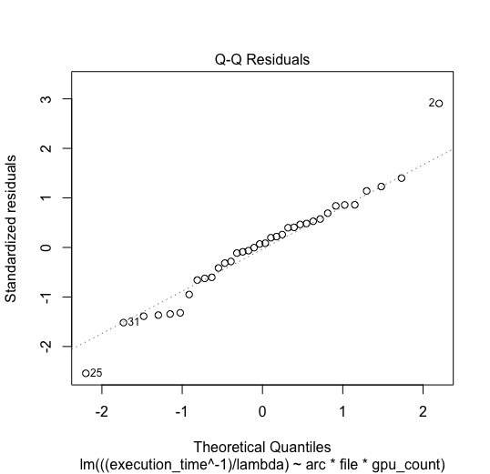
Box-Cox Attempt

Slide 7
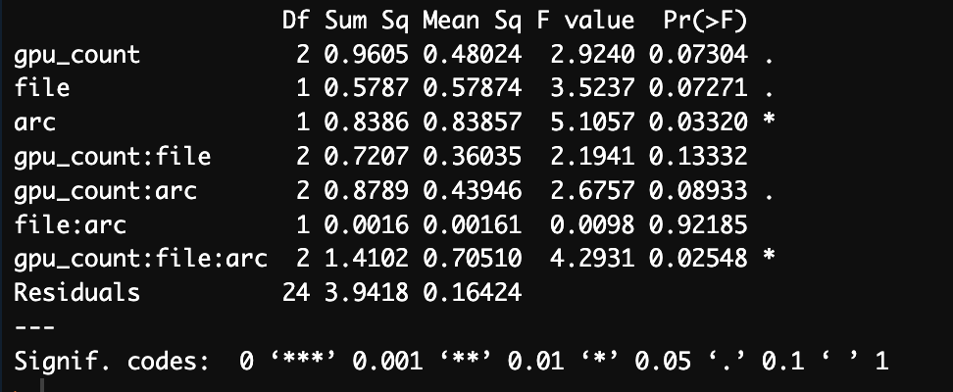
Test For Interactions
Anova shows significant three-way interaction, but our model may be based upon incorrect assumptions of normality.
Let's examine a possible non-parametric method

Slide 8
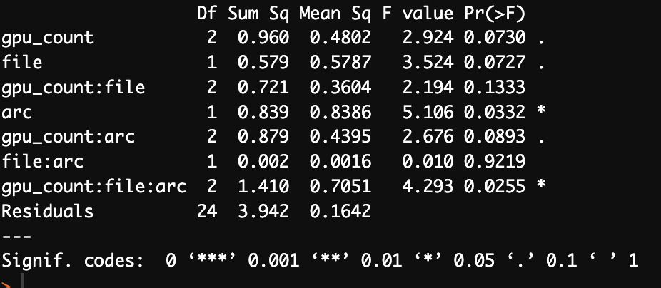
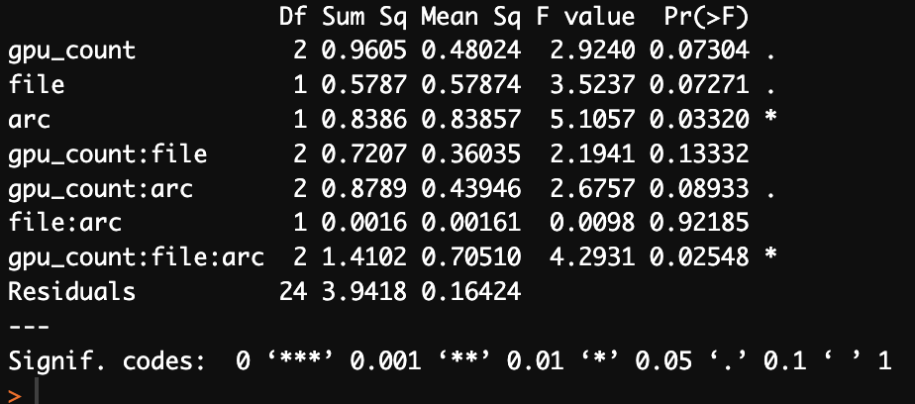
Permutation Methods
Permutation Tests Have Weaker Assumptions Than Conventional Anova
Permute Assignment To Treatment Groups
Calculate Test Statistic For Different Permutation UntilWe Have Approximation Of Distribution
Use This New Distribution To Find P-Value
Parametric Anova
Permutation Anova

Slide 9
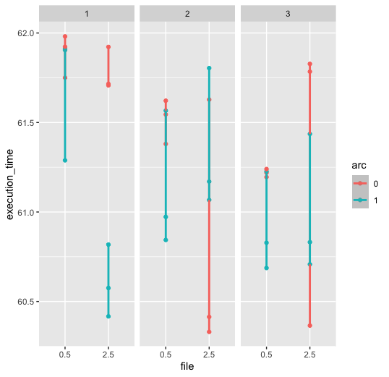
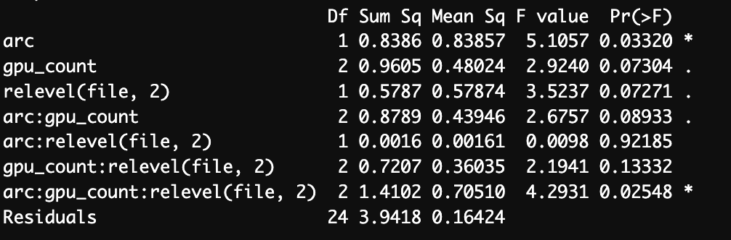
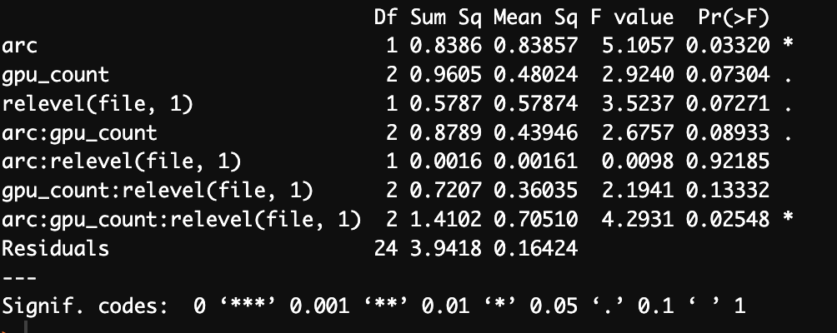
Interaction Plot
No Interaction Clear Through Plot
No Difference In Anova Across Fixed Levels Either

Slide 10
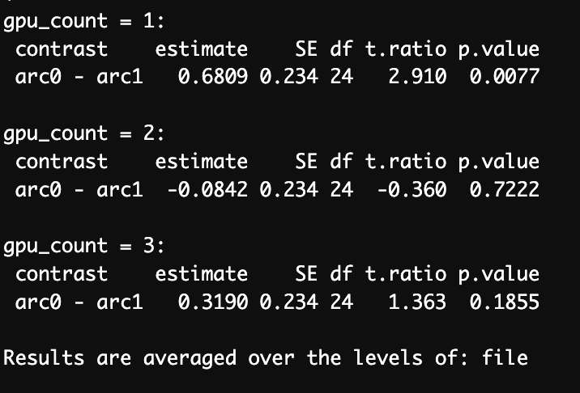
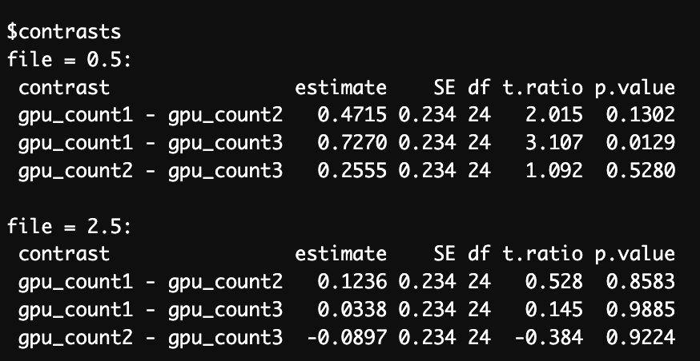
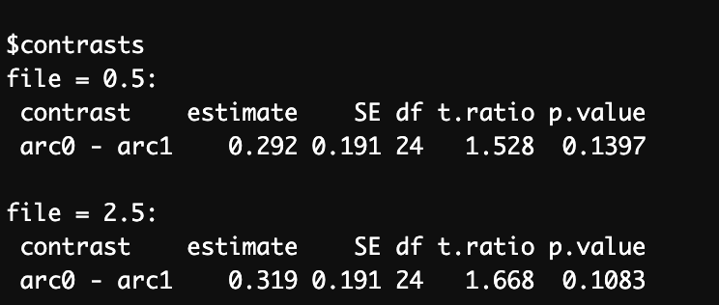
Work With Contrasts
GPU/ Architecture
File Size/GPU Count
File Size/ Architecture

Slide 11
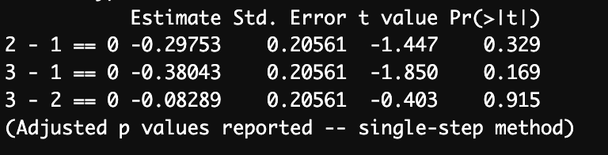
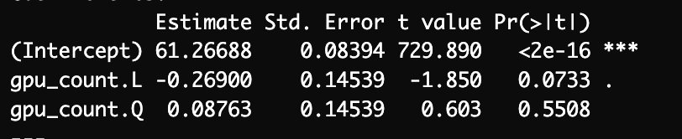
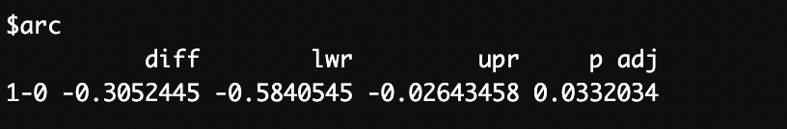
In Review
GPU Contrast Tukey
Significant Effect Found For Architecture.
Significant Three Way Interaction, No Proof Found Through Contrast or Graphical Methods
No Quadratic Term Found For GPU Size
No Significant Difference Between Levels of GPU, Architecture , or File Size
Architecture Tukey
Linear/Quadratic Contrast

Slide 12
Questions?

